Slide 1
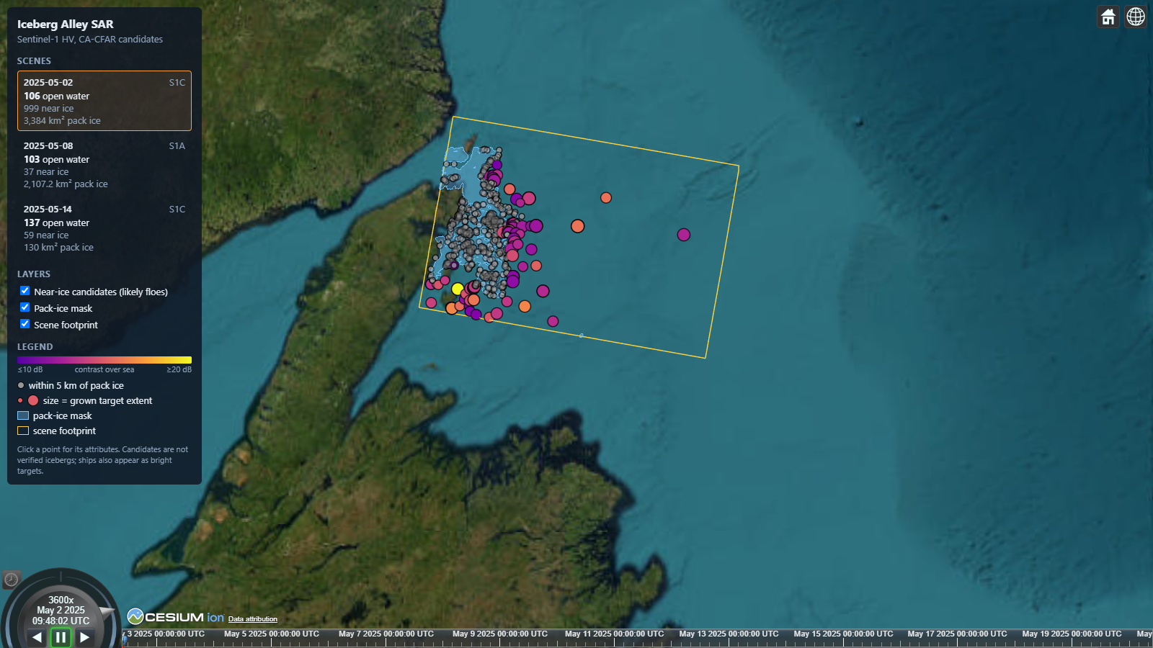
Iceberg Alley SAR
PROJECT BRIEF · SENTINEL-1 SAR
Detecting icebergs off Newfoundland in satellite radar with a classical detector and a foundation model, shown on a live interactive globe.
Natali Kovalski · October 2026
Notes:
A portfolio project: hands-on SAR and maritime-domain work, from raw Sentinel-1 scenes to a validated detector and a CesiumJS viewer. Fifteen years of photogrammetry and geospatial AI, applied to a new sensor.

Slide 2
Every spring, icebergs drift into busy water
THE PROBLEM
01
02
03
The hazard
The gap
The idea
Greenland bergs ride the Labrador Current down "Iceberg Alley", past shipping lanes, fishing grounds and offshore platforms.
Aircraft reconnaissance is costly and limited by weather, and this coast is often fogged in.
Satellite radar sees through cloud and darkness. Sentinel-1 data is free and revisits every few days.
Iceberg Alley SAR · Project brief
2
Notes:
Area of interest: the northeast Newfoundland coast, roughly Bonavista to St. Anthony, extending offshore. April to June has the most icebergs.

Slide 3
Six steps from raw scene to globe
APPROACH
01
02
03
04
05
06
Search
Calibrate
Mask
Detect
Filter
Publish
ASF search for HH+HV scenes over the AOI
HyP3 terrain correction: gamma0, linear power, 10 m
Land plus 500 m from OSM; pack ice from HV texture
CA-CFAR on HV, threshold set from the scene's speckle
Size limits, ice-strip rejection, HH co-pol check
GeoJSON and CZML, published to a live web viewer
Every parameter lives in config.yaml, with lengths in metres so tuning carries over between 10 m and 20 m pixels.
Iceberg Alley SAR · Project brief
3
Notes:
Steps 4 and 5 (orange) are the detector itself. Each detection keeps its incidence angle, contrast, size and distance to pack ice as attributes.

Slide 4
Four ideas behind the detector
SAR IN ONE SLIDE
Backscatter
Polarization
Calm water reflects radar away and looks dark. An iceberg's facets send energy back and look bright.
Sea clutter is far weaker in cross-pol (HV), so bergs stand out there. HH is the second check.
Speckle
CFAR
Grainy noise in every SAR image. Its strength (ENL) is measured per scene and sets the threshold.
Each pixel is compared with its local background, so false alarms stay rare in calm and rough seas.
Iceberg Alley SAR · Project brief
4
Notes:
A subtlety worth mentioning: HyP3 removes the HV thermal noise floor, so open-water HV sits at -30 to -40 dB with ENL below 1. A textbook ENL would set the threshold far too low, so ENL is estimated from each scene. Detection runs on linear power; dB is for display and reported values.

Slide 5
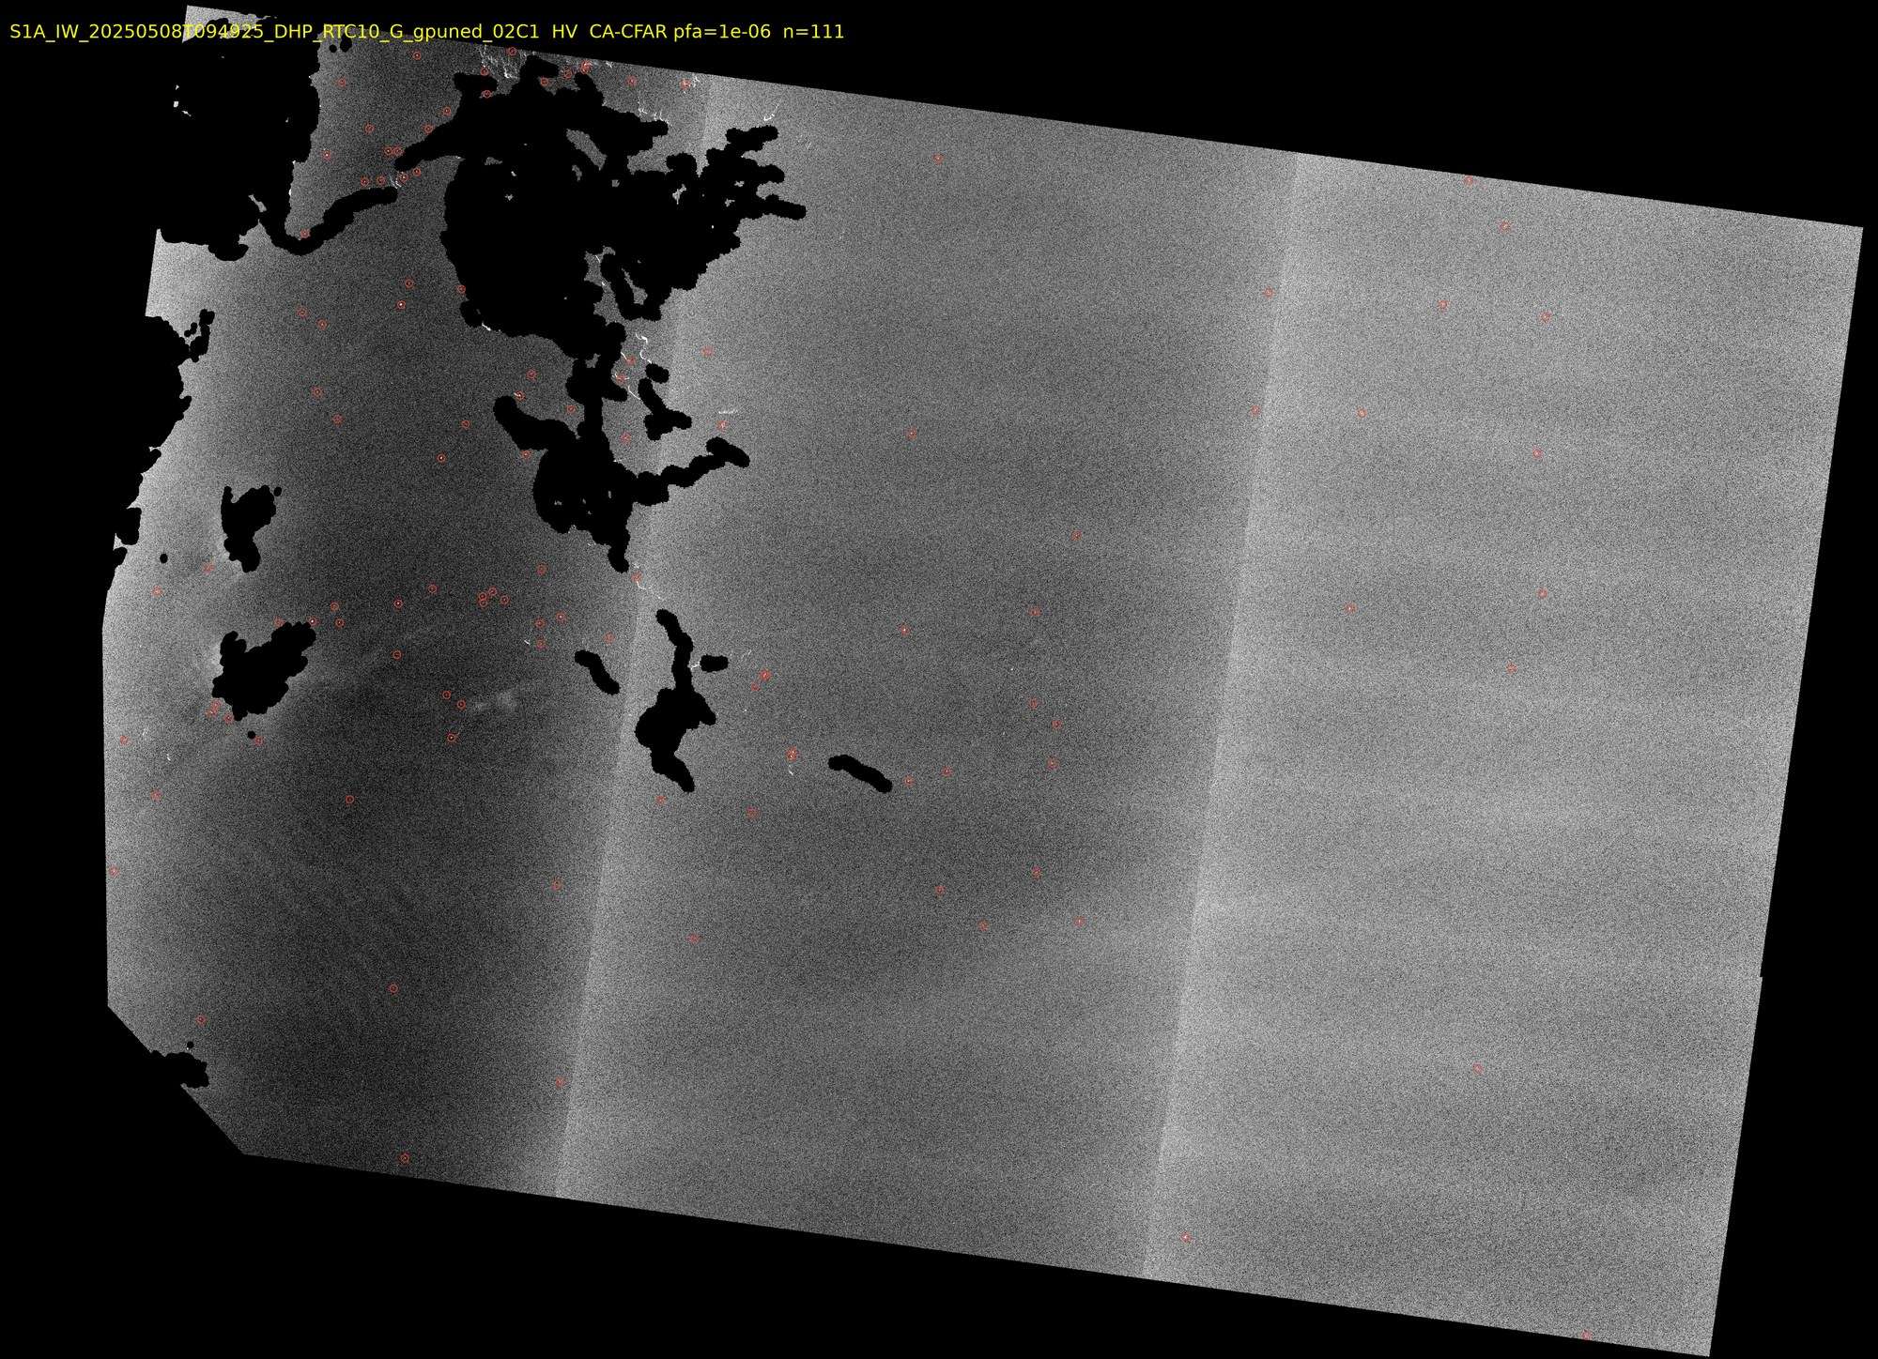
CFAR on HV, then three filters
DETECTION
Threshold from a 10⁻⁶ false-alarm rate, speckle measured per scene
Size: 2 px to 0.8 km²
Ice strips: reject bright structures longer than 300 m
HH check: at least 6 dB above background in both polarizations
HV, 2025-05-08. Land and pack ice masked (black), 111 detections circled.
Iceberg Alley SAR · Project brief
5
Notes:
The HH check matters at 10 m: IW GRD is oversampled (true resolution about 20 m), so HV speckle grains span about 2x2 pixels and pass the size filter. Real targets are bright in both polarizations. Thin strips of loose sea ice were the main false-alarm source until the structure-length filter. The vertical brightness steps in the image are the three IW sub-swaths.

Slide 6
Every candidate on a globe, by date
VIEWER
32 passes, 2019–2026, live on GitHub Pages
Scrub the timeline, click a target to see its attributes
Orange dots: CA-CFAR. Cyan rings: THOR (toggle)
Grey: within 5 km of pack ice, likely floes
Iceberg Alley SAR · Project brief
6
Notes:
Vue 3, Vite and CesiumJS. At startup the viewer reads a manifest and loads one CZML file per scene and detector, so no scene names are hardcoded. `cli.py publish` writes the data, and a push to main deploys it with GitHub Actions. Esri imagery basemap, so no Cesium ion token is needed. Nothing is deleted: near-ice candidates are greyed out and can be hidden with a checkbox. Live: natali-kovalski.github.io/iceberg-alley-sar

Slide 7
HEADLINE RESULT
78%
of the icebergs that International Ice Patrol analysts marked on the same Sentinel-1 pass were found: 207 of 267.
2019-04-29 · median position difference 67 m · recall steady at 73–84% from the coast to 100 km offshore
Iceberg Alley SAR · Project brief
7
Notes:
Validation uses spring 2019 because the IIP sightings database (NSIDC G00807) ends with the 2021 season. Same pipeline, same parameters as the 2025 scenes. Matching is one-to-one within 500 m. IIP positions are truncated to 0.1 arc-minute; moving them to the cell centre cut the median offset from 137 m to 67 m without changing recall. Caveat: the analysts looked at the same radar image, so this measures agreement with expert interpretation, not independent truth.

Slide 8
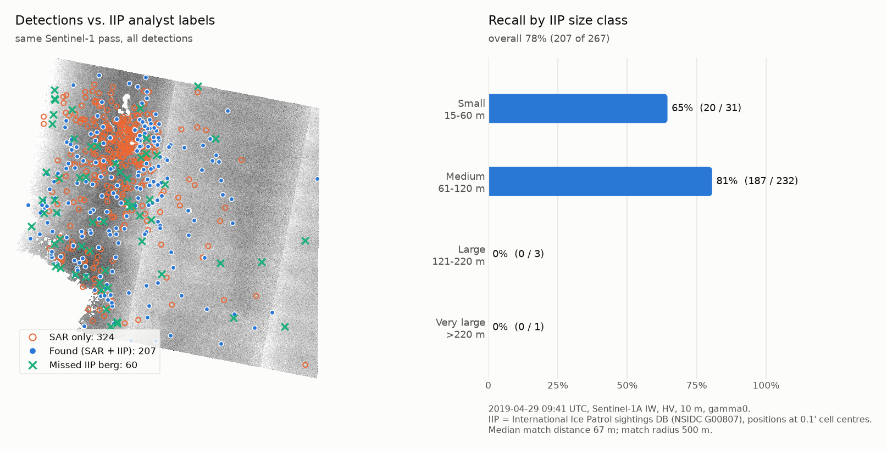
Medium bergs are found best
RECALL BY SIZE
Berg size | Recall
Small, 15–60 m | 65%
Medium, 61–120 m | 81%
Large, over 120 m | 0 of 4
All | 78%
Detections vs. IIP analyst labels, 2019-04-29.
Iceberg Alley SAR · Project brief
8
Notes:
The four large bergs are 30+ dB above the sea in HV, so the CFAR threshold fires on them. But each grown blob measures 340–470 m, above the 300 m ice-strip rule (max_structure_m), so the filter throws them away. THOR has no such rule and finds most of them (next slides). Small bergs that are a single 10 m pixel in HV are removed by the 2-pixel minimum.

Slide 9
Every ground-truth source has a catch
VALIDATION
Source | What it gives | Outcome
NAIS iceberg chart | Counts per 1° square | Within 2–4×, but opposite errors cancel
IIP aircraft sightings | Positions 5–7 h after the pass | Inconclusive: drift unresolved
Sentinel-2 optical | Bright objects at 10 m | Loose sea ice in April, bergs inshore in June
IIP labels, same pass | Positions on the same image | Headline: 78% recall, no drift
Where truth comes hours later, the code estimates a common drift offset and checks it against chance. If the peak is weak, it reports "drift unresolved" instead of a score.
Iceberg Alley SAR · Project brief
9
Notes:
NAIS charts are partly modelled and include growlers too small for SAR. Inshore, SAR finds 3 to 8 times the chart count; offshore on rough days it finds fewer. Sentinel-2 in April showed up to 37,800 bright objects per tile, mostly ice floes, so optical cannot separate small bergs from floes at 10 m.

Slide 10
A frozen foundation model, a tiny head
SECOND DETECTOR
01
02
03
Frozen encoder
769-parameter head
Same masks
THOR Tiny (FM4CS, Apache 2.0), pretrained on Sentinel-1 sigma0. It takes HH/HV natively and is never fine-tuned.
A linear layer on cached features, trained on IIP labels from 2019–2020 frames. All of April 2019 is held out.
Peaks must fall on the CFAR's masked raster. Output is the same GeoJSON, plus a score, so both run through one validation.
Iceberg Alley SAR · Project brief
10
Notes:
Reference: Forgaard et al., 'Efficient iceberg detection in Sentinel-1 imagery using the THOR foundation model', IGARSS 2026. HyP3 gives gamma0, so it is converted to sigma0 with the incidence angle and normalized with THOR's dB statistics. At 8x8 patches a token covers 80 m. A CenterNet-style head was tried too; it matched but never beat the linear head on the 2019/2020 year folds, so the linear head is the main model.

Slide 11
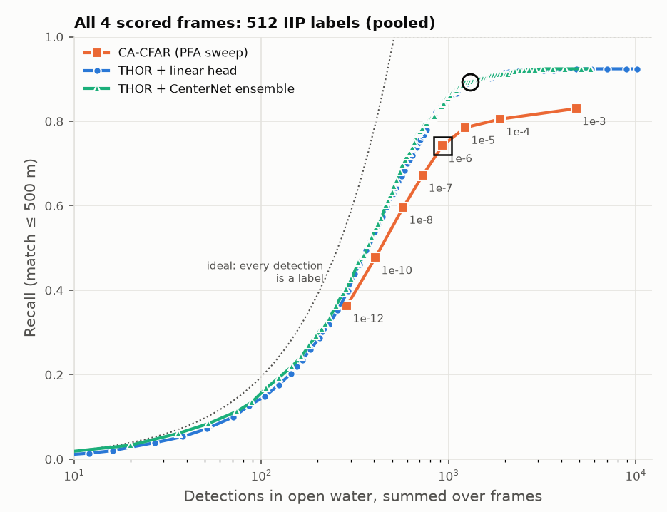
10 points more bergs at the same count
THOR VS. CA-CFAR
Recall | CFAR | THOR
4 frames, 512 bergs | 0.74 | 0.84
2019-04-29 only | 0.74 | 0.89
Medium, 61–120 m | 0.76 | 0.87
Large, over 120 m | 4 of 14 | 11 of 14
Small, 15–60 m | 0.71 | 0.71
Recall vs. open-water detections, 4 held-out frames. Square: CFAR at PFA 10⁻⁶.
Iceberg Alley SAR · Project brief
11
Notes:
Four held-out April 2019 frames with same-pass IIP labels (512 bergs), identical masks and 500 m matching. Precision can't be measured without AIS, so the comparison is recall at a matched number of detections: the CFAR is swept over PFA, THOR over its score, and both are read at the CFAR's count at PFA 1e-6. Nothing was tuned on these frames. THOR leads on every frame (by 0 to 15 points) and matches the CFAR's recall with about 28% fewer detections. Caveat: one month of one year, and THOR learned from IIP analyst labels.

Slide 12
What the numbers don't show yet
LIMITS AND NEXT STEPS
Limits
Next
Precision unknown: 324 of 531 detections on the test pass have no label (bergs, boats or clutter)
CFAR drops large bergs: 4 of 14 found; its ice-strip rule rejects them
Rough seas raise the HV background 3–4 dB
THOR needs the pipeline: the pack-ice mask, and a GPU
AIS ship positions for the test passes, to measure precision
Shape-based strip test, so the CFAR keeps large bergs
THOR at 4×4 patches for small bergs
OS-CFAR or K-distribution for heavy-tailed sea clutter
Iceberg Alley SAR · Project brief
12
Notes:
39% (207 of 531) is a lower bound on precision, not an estimate. The unlabelled detections are strong targets, similar in size to matched ones. On its own, THOR fires on pack ice: 34–82% of its peaks on icy frames fall inside the CFAR's ice mask. An experimental iceberg-vs-ship CNN trained on the Kaggle Statoil/C-CORE chips exists, but it is mostly unsure on our data and is used only as a review hint.

Slide 13
One command, end to end
BUILD
python -m iceberg_sar.cli run --start 2025-05-01 --end 2025-05-15
Processing
Data
Viewer
Quality
Python 3.11, NumPy, SciPy, rasterio, GeoPandas, PyTorch
asf_search, HyP3 RTC, OSM land polygons, IIP sightings
Vue 3, CesiumJS, CZML, deployed by GitHub Actions
153 pytest tests, all parameters in config.yaml
Re-runs reuse downloaded scenes and outputs, and a dry run shows the HyP3 credit cost first. Then publish and git push update the live viewer.
Iceberg Alley SAR · Project brief
13
Notes:
The run searches ASF, keeps the best-covering HH+HV scenes, orders HyP3 RTC processing (60 credits per 10 m scene), then masks, detects and exports CZML. Masking plus detection takes about 17 minutes per 10 m scene on a laptop. THOR inference needs a GPU: 8–15 minutes per scene on a laptop RTX 3070.

Slide 14
Questions?
THANK YOU
Natali Kovalski · github.com/natali-kovalski/iceberg-alley-sar
Live demo: natali-kovalski.github.io/iceberg-alley-sar. Contains modified Copernicus Sentinel data (2019–2026). Iceberg data: International Ice Patrol (NSIDC G00807) and the North American Ice Service. THOR weights: FM4CS (Apache 2.0). Land polygons © OpenStreetMap contributors.
Notes:
The repository has the full write-up: method, validation findings and limitations, plus the viewer.

